Slide 1
Empowering the Elderly:
Adoption of Connected Health Tech by Seniors
HIMSS EVENT
Global Health Conference & Exhibition | March 9–13, 2020 | Orlando, FL

Slide 2
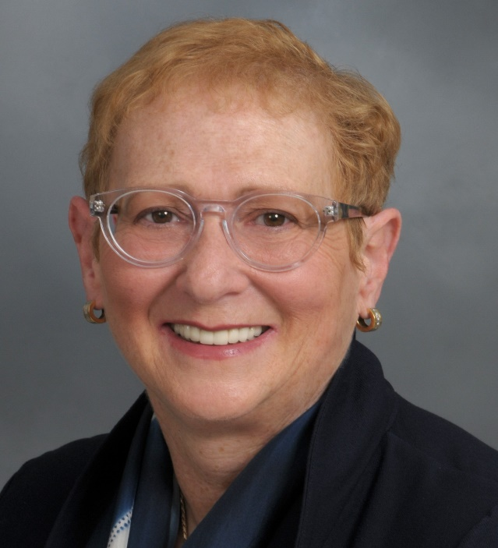

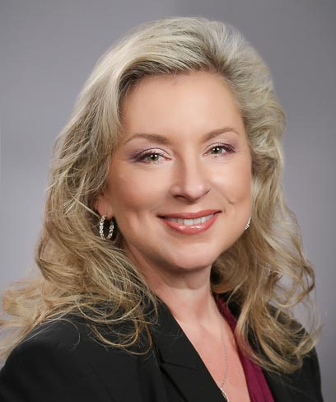
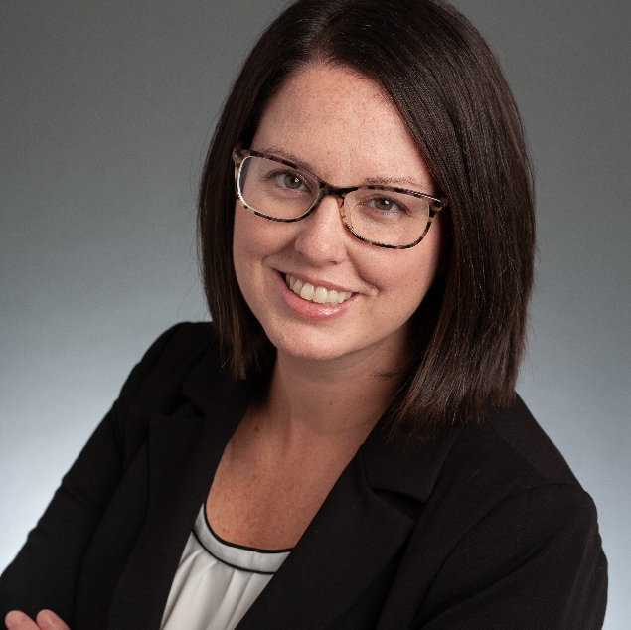

Panelists
Elinor Schoenfeld, PhD
Research Associate Professor
Stony Brook Medicine
elinor.schoenfeld@stonybrook.edu
Nancy M. Green – Moderator & Co-Chair PCH Alliance Aging & Tech Task Force
Fran Ayalasomayajula
Co-Chair PCH Alliance Aging & Tech Task Force
President
The SAA Group
Nancy@thesaagroup.com
Jennifer Kent
Senior Director
Parks Associates
jennifer.kent@parksassociates.com
Head of Population Health Portfolio, Worldwide Healthcare
HP
frances.a.walls@hp.com

Slide 3
Jennifer Kent
Senior Director
Parks Associates

Slide 4
Adoption of Connected Health and Wellness Devices
12% of seniors own a wearable
© Parks Associates

Slide 5
Appeal of Telehealth Services
Build on seniors’ trust of local providers
One-third of seniors find telehealth services appealing when those services are associated with local care providers and facilities.
© Parks Associates

Slide 6
Must-have Features of Independent Living System
Safety and security top value props
Safety, security, and peace of mind are critical components of seniors’ overall sense of wellbeing.
© Parks Associates

Slide 7
Emerging Health: Smart Home Use Cases
Safety and security top value props
Connected health devices working together with security systems or smart speakers to prompt emergency assistance is highly appealing to almost one-third of seniors.
© Parks Associates

Slide 8
Questions
Jennifer Kent
Senior Director
Parks Associates
@JenniferMKent

Slide 9

Engaging the community in a discussion about home based sensors and aging in place
Elinor Schoenfeld, PhD
Research Professor
School of Medicine
Department of Family, Population & Preventive Medicine

Slide 10
Our Project Goals
  Develop new technologies to help older adults remain at home
    use rigorous research methodologies to evaluate in the lab, health care settings, and then the community before deployment
  Create a technologies based toolkit
  personalized, easy to use, privacy preserving and cost conscious
  monitor health and detect changes in health for early intervention
  create an alert system when a person’s health changes (e.g. falls)
  incorporate additional new technologies as we identify additional needs
Our first step was to build academic-community collaborations
Notes:
We will look to incorporate new technologies that we develop as well as market available technologies that meet the community’s needs

Slide 11
Obtaining stakeholder insights
We are using community engaged research methods to learn from and collaborate with our stakeholders throughout the lifecycle of technology development and implementation
  Stakeholders include: academic researchers, older adults, family and professional caregivers, healthcare providers, community leaders and residents
Using these methods we completed five in-person discussion group sessions and survey data collection with 57 community dwelling older adults
    2 sessions were held in an urban NYC setting (n=24)
    3 sessions were held in a suburban LI setting (n=33)
Notes:
First activity

Slide 12
Discussion session data collection methods
All discussion group participants:
provided Informed consent before each session began
listened to a short presentation by my collaborators Dr. Fan Ye and Dr. Erez Zadok, College of Engineering and Applied Sciences, that described our project and technology’s role in monitoring health and well being as individuals age
completed an anonymous research survey about participant’s technology use and opinions about different kinds of home installed sensors
participated in a discussion to share thoughts on technology and aging in place
Notes:
Prior to the start of our project we obtained SBU IRB approvals. Today I am going to highlight for you some of what we learned from our discussions. Results from the survey will be presented at HIMSS20 in March.

Slide 13
Participant demographics (N=57)
Demographic | n | %
Female | 30 | 53%
Age 60-69 70-79 80-90 | 20 26 11 | 35% 46% 19%
College Graduate | 42 | 74%
Live with spouse | 35 | 79%
Notes:
Overall equal distribution by gender. Demographics significantly differenced by location. Urban location, younger, less educations and less married

Slide 14
What we learned - Older adults aging challenges
Recently became a widow and living alone
Just got discharged from the hospital. I am afraid to be alone, especially at night
Cannot cook much anymore. Can’t stand too long, can’t lift my arms to reach stuff from high cabinets or bend down to take things out of low cabinets
I have no one close by to help me
Taking so many medications, I get confused
I am getting so old, all my friends are either moving away or dying
Want to face-time with my kids but since the internet “broke” I have no one to help me fix it
Having trouble seeing my phone to make calls
I keep fighting with my kids. I want to stay in my home but they are worried that I have trouble with the stairs to get to my bedroom and bathroom
Technology is so expensive and hard to use. I go to the library for Wi-Fi
My hearing is not what it used to be. Cannot hear the doorbell or people on the phone
Had to stop driving. What am I going to do now?
Hard to get assistance on the phone, everything is automated. I need to speak with a person
Don’t want my kids monitoring me. If they know too much….

Slide 15
Participant concerns/questions about home monitoring
Value my privacy. Don’t want people to see me.
I would like to turn the sensors on and off when I want to
What data will be collected and from whom? Do I have to get permissions from visitors before they come into my home?
Added expense. I am on a fixed income.
Security.
Worried about hacking!
Too complicated to use. I am not technologically savvy
I am afraid of loosing my independence if I am monitored at home!
Who will see my data?
Do not want sensors in the bedroom or bathroom. Don’t want my kids to see me naked!
Who will fix it if it breaks!
Don’t want to be overwhelmed by the data
Don’t want data collected on my grandkids when they visit!
How will I share these data with my health care provider?
How will these data help with monitoring my health?

Slide 16
Caregiver concerns caring for an older adult
My dad has so many doctor appointments. How do we balance work and going with him?
My dad forgets to eat. I prepare his food but find it still in the refrig days later!
If mom doesn’t answer the phone when we call, we have to get in the car and drive an hour to make sure she is ok.
My dad has dementia and likes to wander. We cannot always be in the same room to keep track of him.
Wish my aunt wouldn’t leave the stove on and forget about it
My mom has poor balance and falls often. She has been on the floor for hours before someone came home
I am so tired. I don’t sleep. I worry about my wife who gets up at night. She has even walked outside without shoes and a coat!
Wish there was a way to know my husband is ok at home when I have to run errands
My parents want to stay in their home as long as possible. We have no extra room for them to move in
I worry about my parents living 5 miles from the nearest neighbor
Our kids live on the west cost. What good will it do to call them if we have a problem
I cannot watch mom 24 hrs a day!

Slide 17
Summary of what we learned
Discussions informed requirements to develop a sensor system that is flexible enough to accommodate individuals in different life phases, with different levels of comfort, home environments, amount of expendable income, and available support systems
These sessions raised a number of topics for ongoing discussion focusing on the logistics and ethics of technology use in the home by older adults
  Who can sensors collect and store data from? consenting resident, guests, minors?
  What data should be shared and with whom? Under what conditions - routine, emerging problems, emergency situations?
  Whom should reports be shared with? Who is responsible for review of reports? Do not want to overwhelm the individual, their family or providers
  Who owns the data and what can the aggregate, population level, de-identified data be used for and by whom?
Notes:
Some of the questions raised in our discussions are the “BIG QUESTIONS” that are topics for the entire field of personal monitoring that we do not yet have answers to.

Slide 18
Collaborators
Fan Ye, PhD College of Engineering and Applied Sciences, Department of Electrical and Computer Engineering
Erez Zadok, PhD College of Engineering and Applied Sciences, Department of Computer Science
Jignesh Patel MD MS, School of Medicine, Department of Internal Medicine, Division of Pulmonary, Critical Care and Sleep Medicine
Jaqueline Mondros DSW, School of Social Welfare
Patricia Bruckenthal PhD, APRN-BC, FAAN , School of Nursing
Bing Zhou, Zongxing Xie and Xi Cheng, Graduate Students, College of Engineering and Applied Sciences
With thanks to members of the Osher Lifelong Learning Center (OLLI) and Selfhelp whose members participated in our discussion groups
Notes:
Acknowledge my collaborators – a very diverse group representing the College of Engineering, School of Medicine, Nursing and Social Welfare. I would also like to acknowledge our community collaborators who participated in our discussion group sessions.

Slide 19
Questions?
Contact Information:
elinor.schoenfeld@stonybrook.edu
fan.ye@stonybrook.edu

Slide 20
AGING & TECH FORUM: Empowering the Elderly: Adoption of Connected Health Tech by Seniors
Creating a Silver Lining:
The role of universal design in meeting the needs of older adults
Fran Ayalasomayajula, MPH, PMP
Co-Chair PCH Alliance Aging & Tech Task Force
Head of Population Health, Worldwide
HP, Inc.
frances.a.walls@hp.com
Global Health Conference & Exhibition | March 9–13, 2020 | Orlando, FL

Slide 21
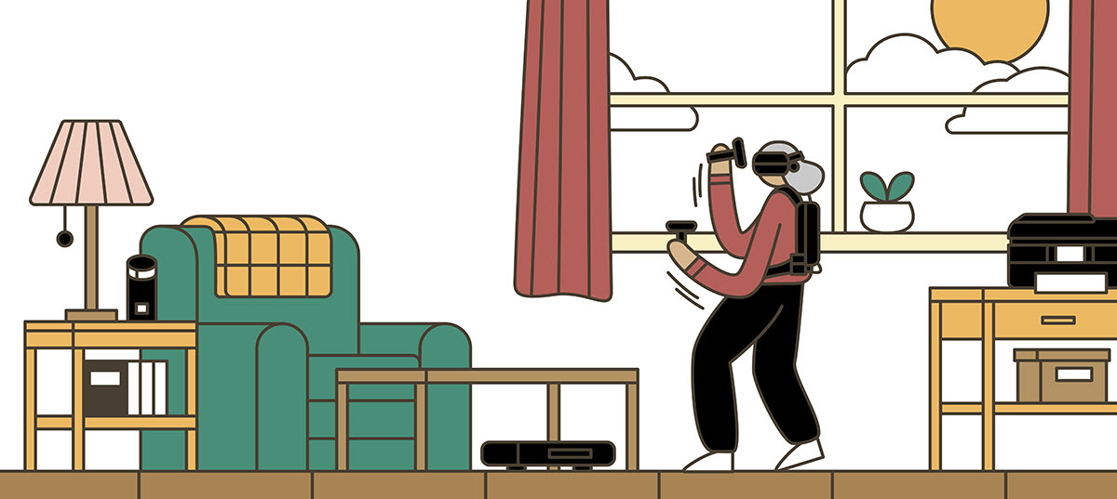
What are users asking for…
Value
Ease of transition
Trusted community
Tech and touch
Consistency and predictability
Long lasting products
Dignity intact
“Nice for my mom, but not for me”

Slide 22
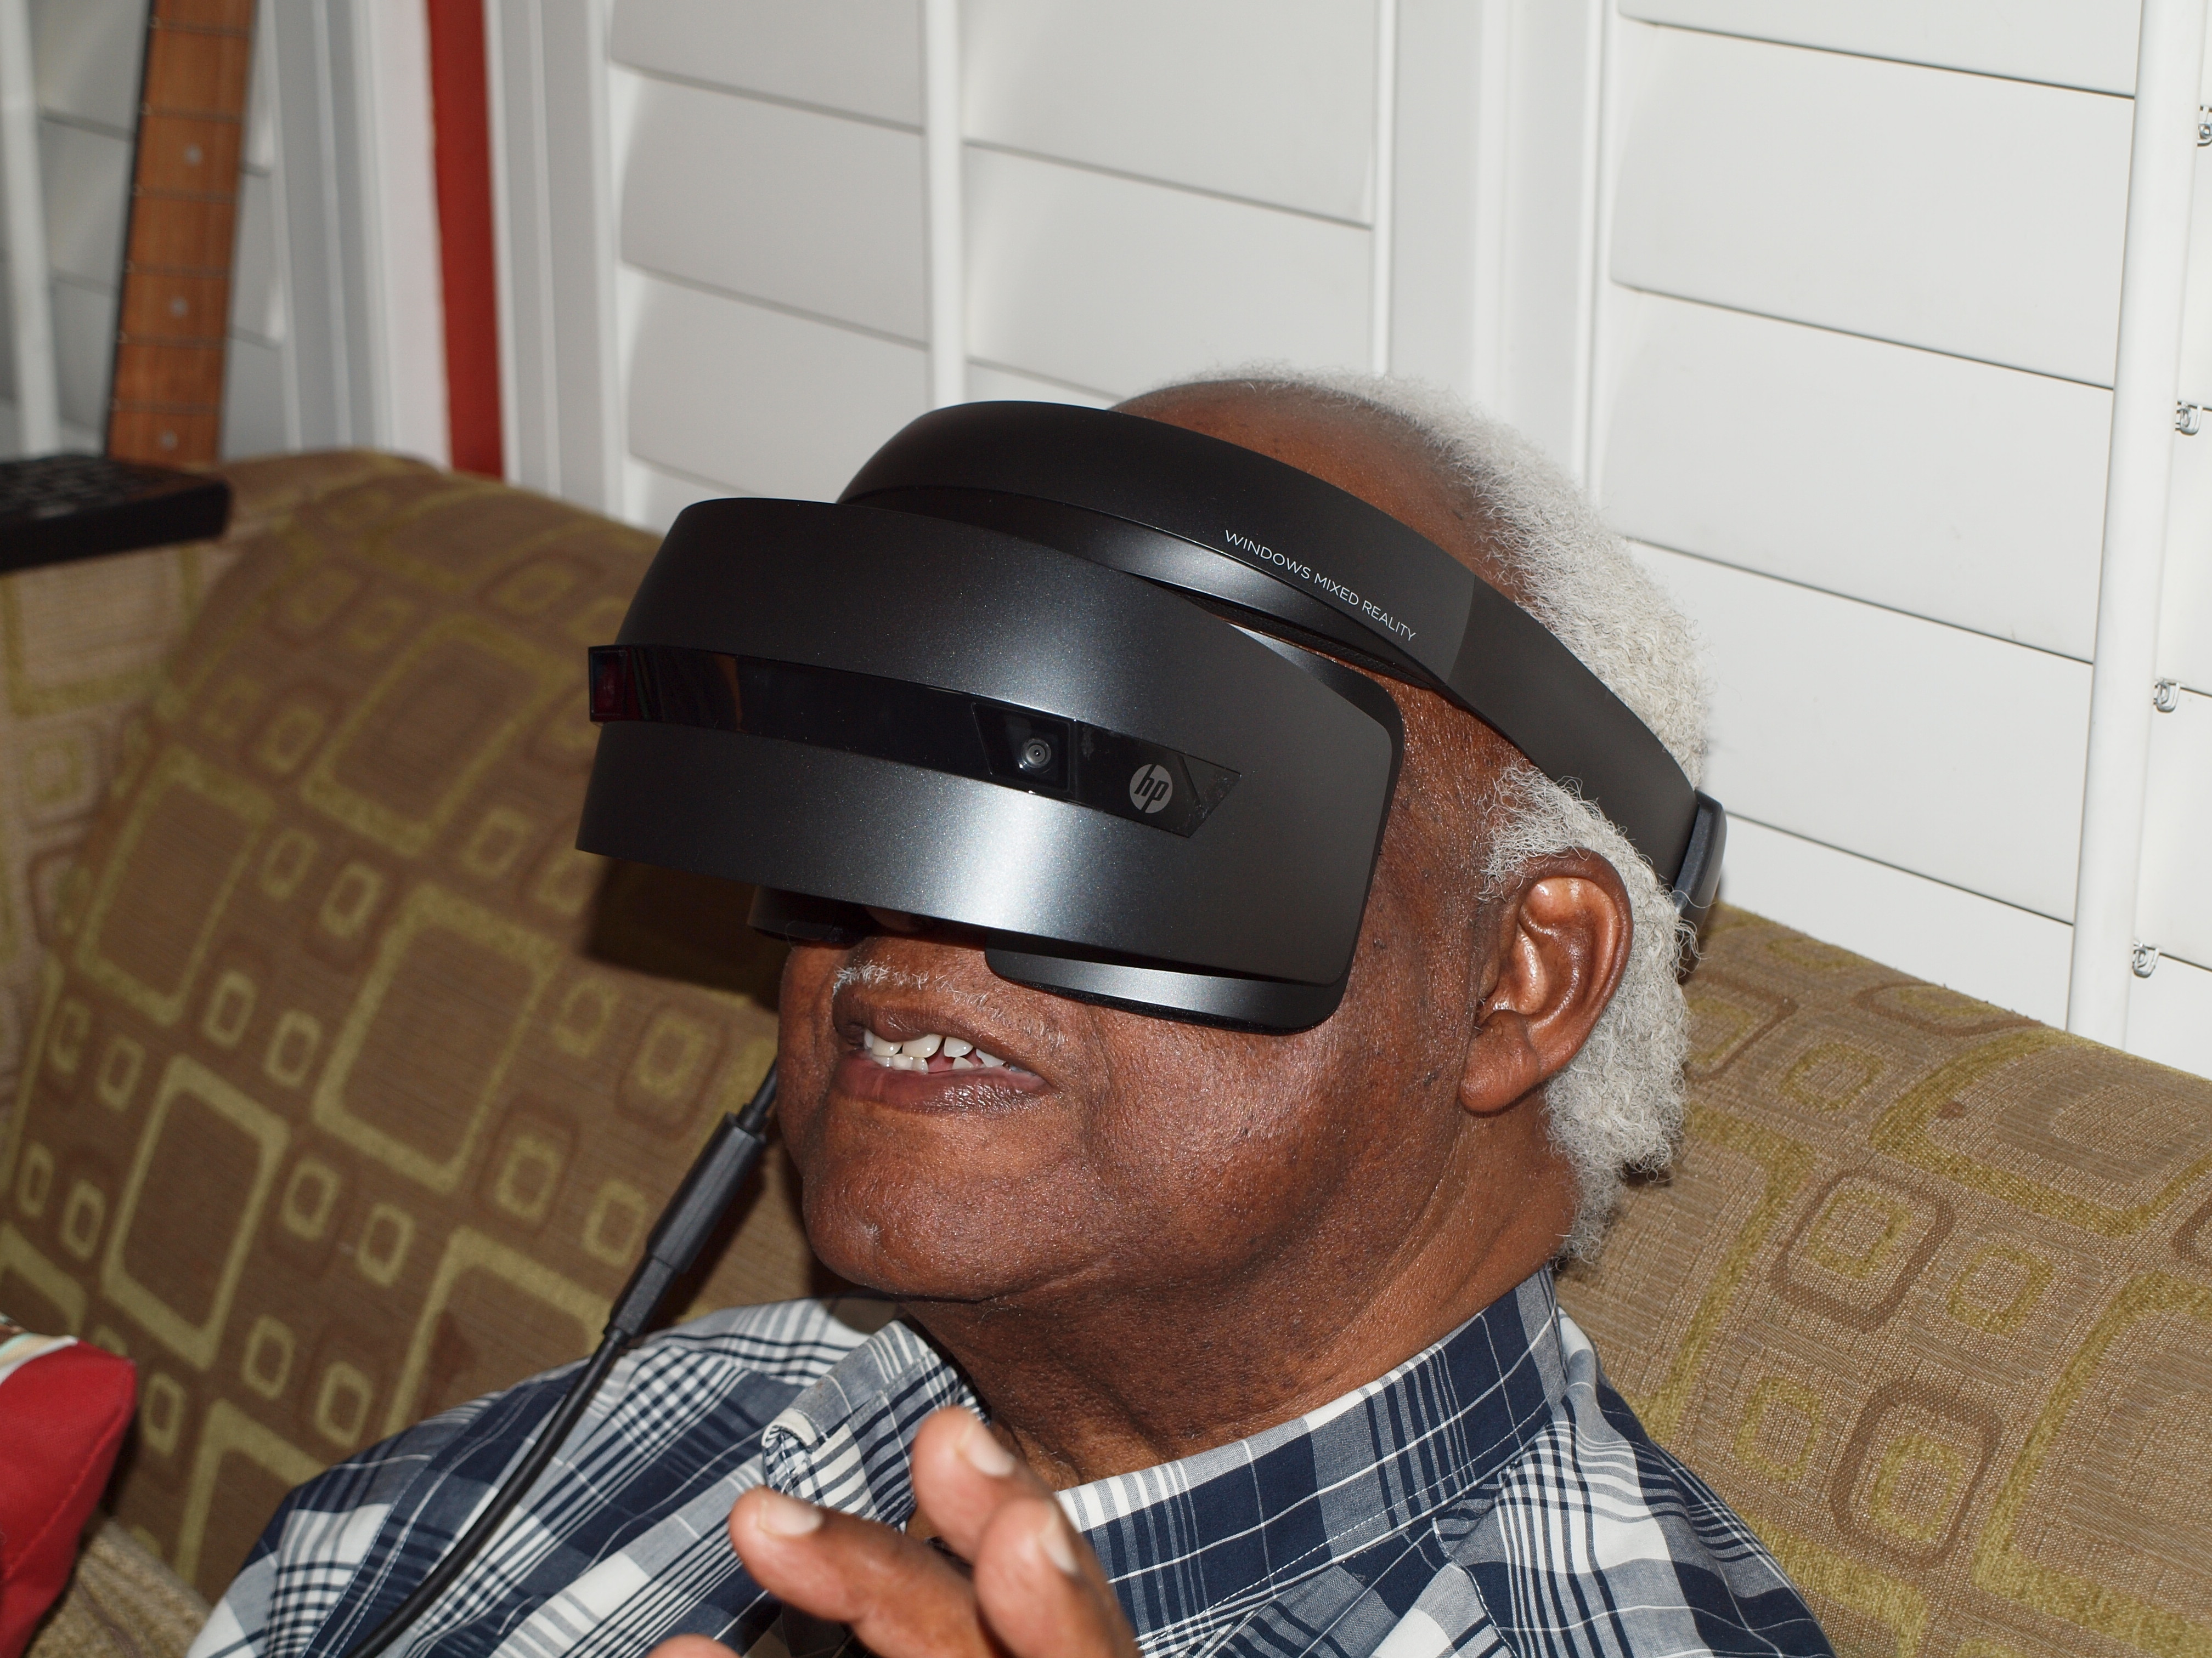
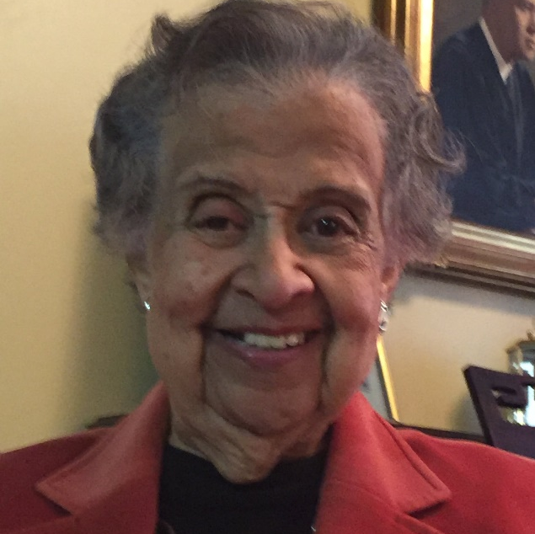
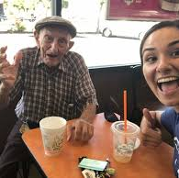
Positive outcomes and growing engagement
  VR is tremendously therapeutic
  - Firsthand Technology, Patient, 2018
  An app that is bringing down barriers
  - Papa, Companion OnDemand, 2019
  Using this [RPM] kit helped me improve my daily routine, so I did not forget my medication.
  - HealthSaaS, CHF Patient, 2019

Slide 23

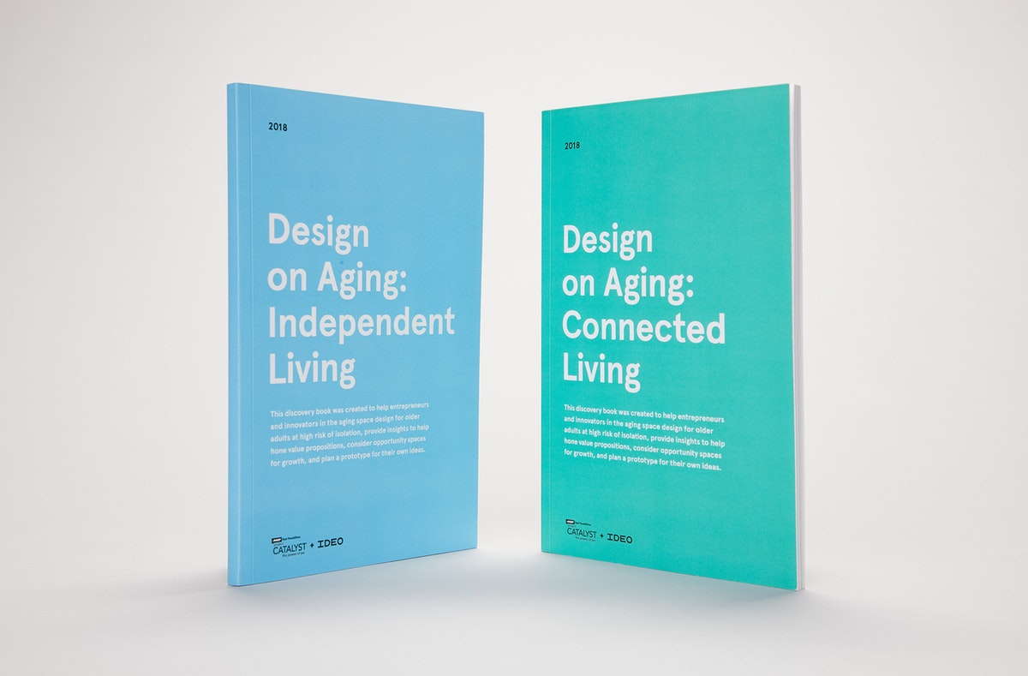
Design for All Ages
Include elderly in usability studies
Apply design principles which level the playing field, including:
  Vision and visual design
  Hand-eye coordination
  Ergonomics
  Hearing and sound
Recognize the market opportunity for users, families, and their caregivers
Tools and Insights for Enhancing the Lives of Older Adults, IDEO

Slide 24
4 Ways to get involved
Revisit your organization’s business strategies, culture and employee engagement programs
Solicit the participation of local organizations and community groups
Ask us about the PCHA Aging and Technology Taskforce
Check out PCHA’s growing library on related topics

Slide 25
Contact
Information:
Fran Ayalasomayajula
Head of Population Health
HP Inc.
frances.a.walls@hp.com
linkedin.com/in/franceswalls
@fawalls

Slide 26
Questions
Please enter your questions into the questions box

Slide 27
Panelists
Elinor Schoenfeld, PhD
Research Associate Professor
Stony Brook Medicine
elinor.schoenfeld@stonybrook.edu
Nancy M. Green – Moderator & Co-Chair PCH Alliance Aging & Tech Task Force
Fran Ayalasomayajula
Co-Chair PCH Alliance Aging & Tech Task Force
President
The SAA Group
Nancy@thesaagroup.com
Jennifer Kent
Senior Director
Parks Associates
jennifer.kent@parksassociates.com
Head of Population Health Portfolio, Worldwide Healthcare
HP
frances.a.walls@hp.com

Slide 28
Invitation: HIMSS20 Pre-Conference
Aging & Tech Forum: Addressing the Silver Tsunami
Monday, March 9, 2020 | 8:00am - 4:30pm
With the ‘silver tsunami,’ comes a need to reinvent care delivery for seniors who are living longer than ever, with most not experiencing perfect health. The forum will examine how virtual care and other technologies are: 1.) being used to manage chronic-care seniors in the home; 2.) help seniors who are thriving to live the active lives they choose for as long as they can.
This year’s event continues the conversation but through a different lens: half the day will be devoted managing chronic care seniors in the home; and half to helping active seniors, who are living longer than ever, maintain their independence and role in society.
Key takeaways:
How can provider organizations bring care to the home?
What innovations are working and ready to scale?
Addressing current and future needs, including extra disease burden and shortages of healthcare providers
Case-studies from the field

Slide 29
Thank You!
Recording will be available by end of day today!

